Slide 1


ESPN cricinfo
Title: Web Scraping and Exploratory Data Analysis of ESPN Cricket Batting Data

Slide 2
About Me:
I am KHAJA MAINUDDIN B.TECH graduate with a strong passion for Data Analytics and Visualization.
Skilled in exploring real-world datasets to uncover meaningful insights.
Experienced in web data extraction and cleaning using Python tools.
Continuously learning to enhance expertise in data science and analytics tools.
GITHUB - https://github.com/Mainuddin123
LINKEDIN - https://www.linkedin.com/in/shaik-khajamainuddin

Slide 3
Preface:
INTRODUCTION
BUSINESS PROBLEM
OBJECTIVE
TOOLS USED
WEB SCRAPPING
DATA CLEANING STEPS
DATA VISUALIZATION
CONCLUSION

Slide 4
Introduction:
Cricket generates a large amount of performance data.
This data is available online but not in a structured format.
Platforms like ESPN Cricinfo provide detailed player statistics.
In this project, we use web scraping and EDA to analyze ODI batting performance.

Slide 5
Business Problem:
Cricket performance data is available online but lacks structured format for analysis
Manual evaluation of large datasets is inefficient and error-prone
Comparing players using multiple performance metrics is challenging
A data-driven approach is required to derive meaningful insights and support decision-making

Slide 6
Objectives:
Extract structured ODI batting data using web scraping
Evaluate player performance using core metrics like Runs, Average, and Strike Rate
Identify high-performing players through data-driven analysis
Analyze relationships between variables to discover performance patterns

Slide 7
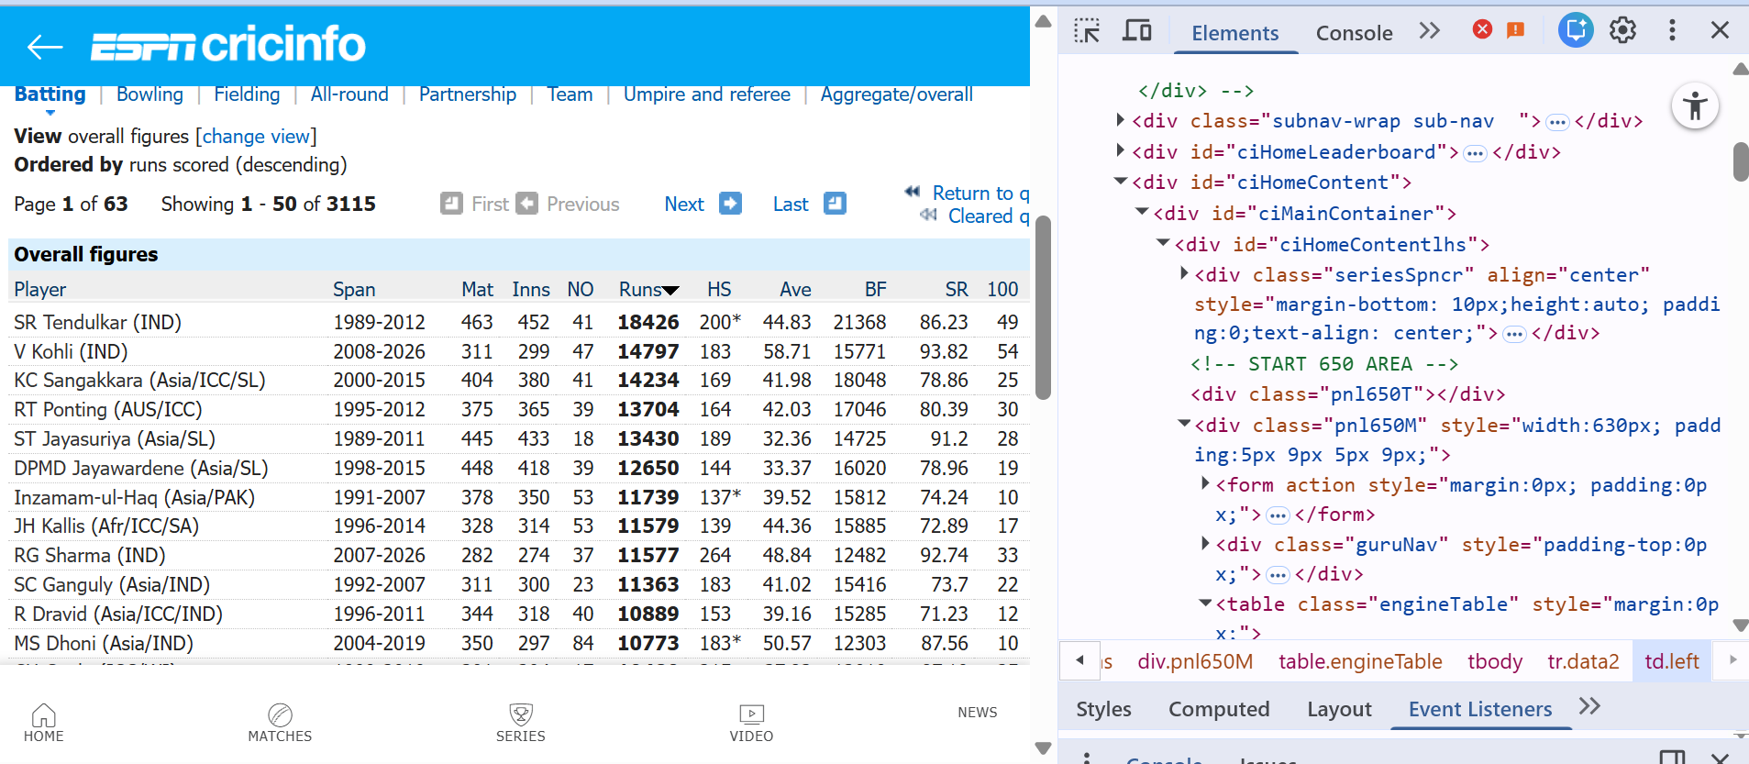
Web Scraping:
ESPN Cricinfo was used as the data source.
Inspected the webpage to find the data table.
Used Requests to get webpage data.
Used BeautifulSoup to extract required data.
Collected data from multiple pages.
Implemented pagination to collect 500+ records

Slide 8
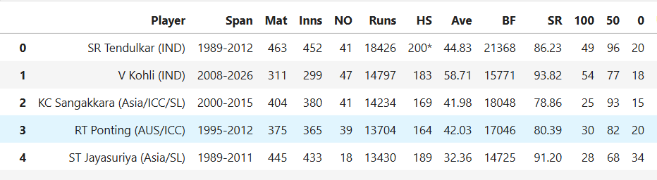
Dataset:

Slide 9






Tools Used:

Slide 10
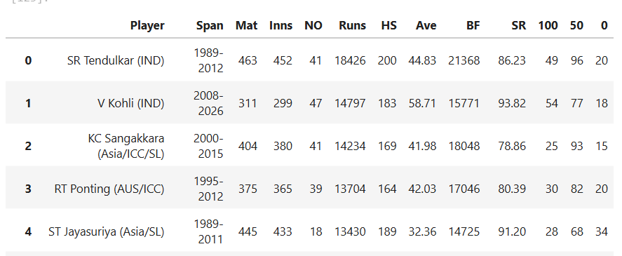
Data Cleaning Steps:
Cleaned special characters to maintain data consistency
Treated missing values using NaN for accurate processing
Ensured correct data types by converting columns to numeric format
Removed duplicate entries to improve data quality
Standardized column names for better readability and analysis

Slide 11
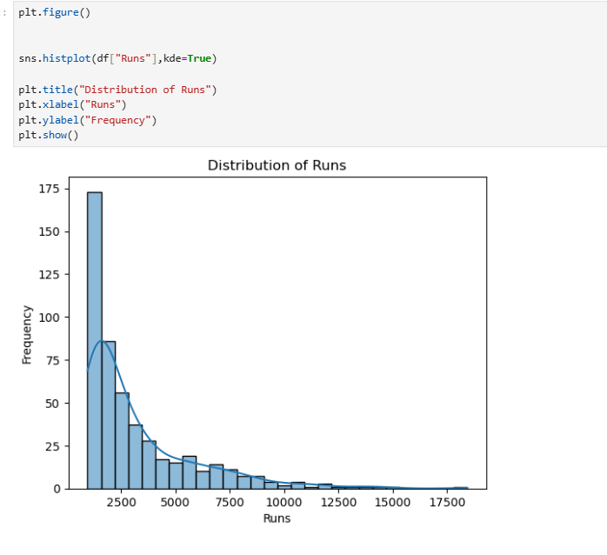
Data Visualization: HISTOGRAM (RUNS DISTRIBUTION)
Distribution of runs is right-skewed
Majority of players have lower run totals
Few players have extremely high runs
Indicates unequal performance distribution
Elite players dominate overall statistics

Slide 12
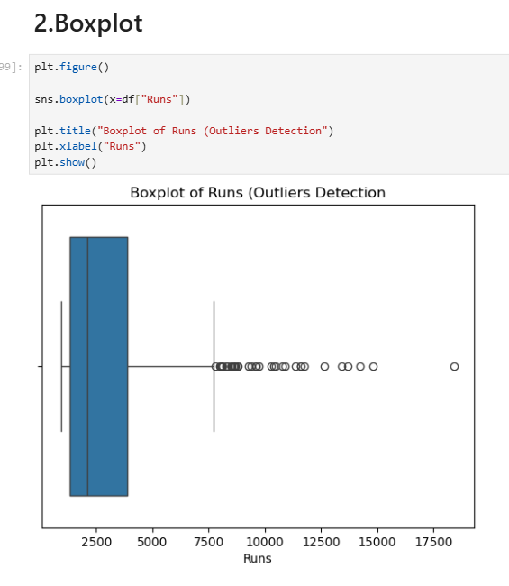
Data Visualization:
BOX PLOT (OUTLIERS)
Boxplot shows spread of runs clearly
Most players fall within a moderate range
Several extreme outliers present at higher end
Outliers represent top-performing players
Large gap between average and elite players

Slide 13
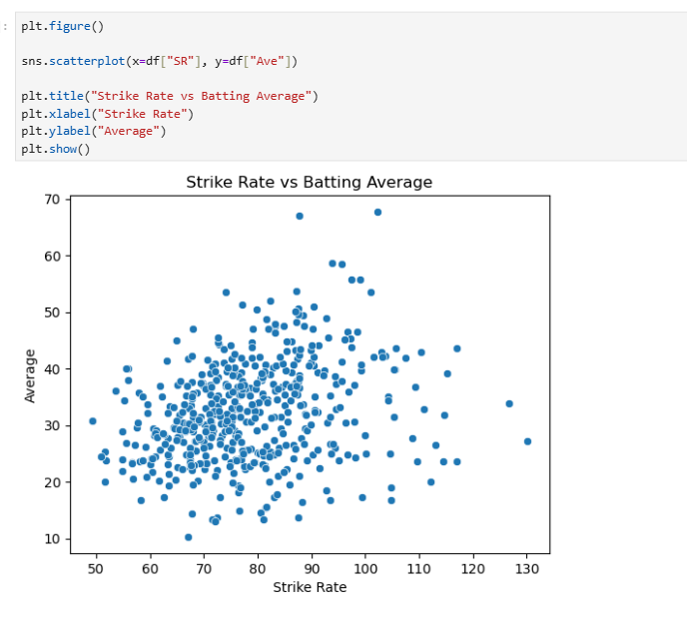
Data Visualization:
Strike Rate vs Average
(Scatter Plot)
Shows relationship between strike rate and average.
Slight positive trend observed
Points are widely scattered
High variability in player performance
Scoring speed does not guarantee consistency

Slide 14
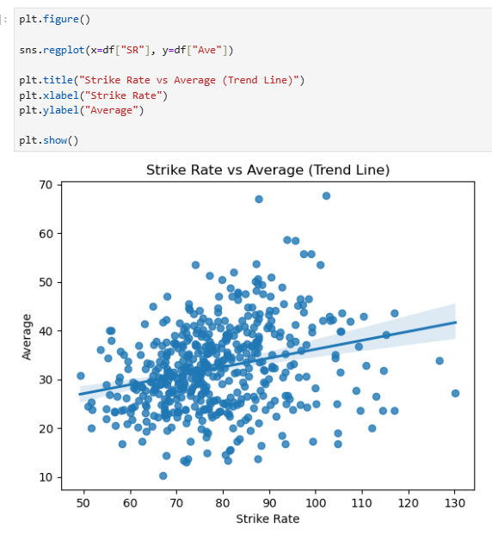
Data Visualization:
Regression Analysis
Regression line shows upward trend
Indicates weak positive correlation
Data points are highly dispersed
Relationship is not strong
Not reliable for prediction

Slide 15
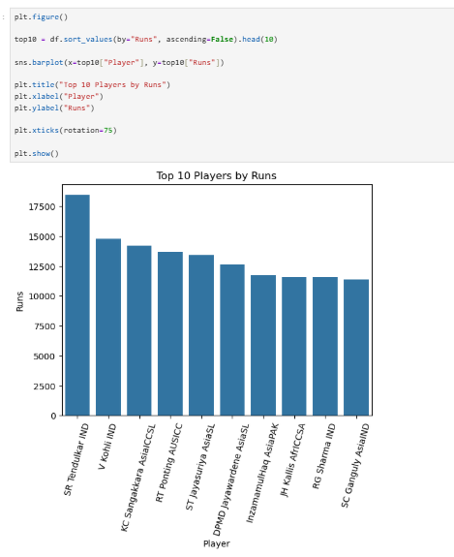
Data Visualization:
Top 10 Players (Bar Chart)
Displays top 10 players by runs
Top players score significantly higher
Clear gap between highest and others
Performance concentrated among few players
Highlights dominance of elite players

Slide 16
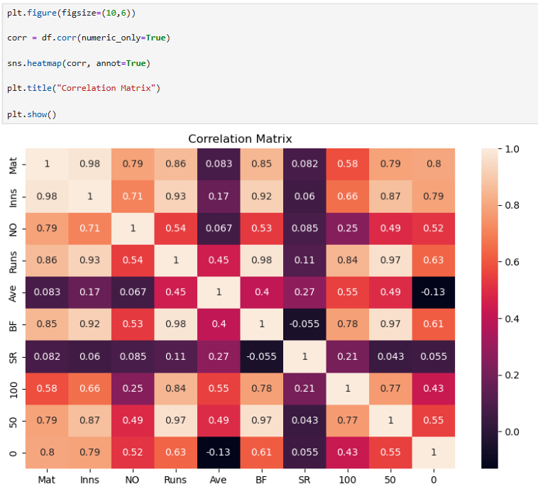
Data Visualization:
HEATMAP (CORRELATION)
Runs strongly correlated with Matches
Runs strongly correlated with Balls Faced
Average shows moderate correlation with Runs
Strike Rate has weak correlation with Runs
Performance depends more on opportunities than speed

Slide 17
Conclusion:
Runs Dominance by Few Players A small group of players contributes a large portion of total runs, showing that performance is concentrated among top players.
Matches Strongly Impact Runs There is a strong relationship between matches played and total runs, indicating that more opportunities lead to higher scoring.
Limited Impact of Strike Rate Strike rate shows only a weak relationship with total runs, meaning aggressive scoring does not always result in higher totals.
Player Performance Varies Widely Batting performance differs significantly across players, highlighting different playing styles and consistency levels.

Slide 18
Experiences & Challenges:
Faced issues with pagination in scraping
Data was unstructured and inconsistent
Handling missing values was challenging
Converting data types required preprocessing
Ensuring clean and accurate dataset

Slide 19


Slide 20

THANK YOU

